Slide 1
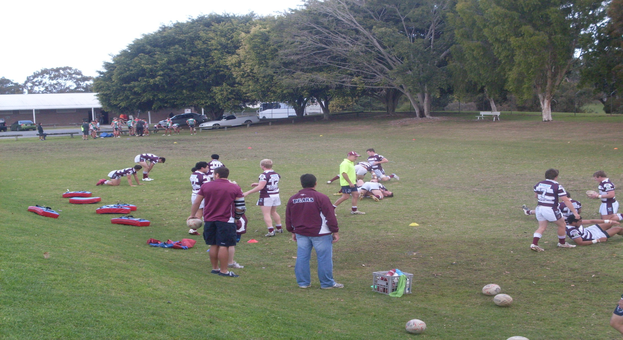
How should we play? You decide

Slide 2
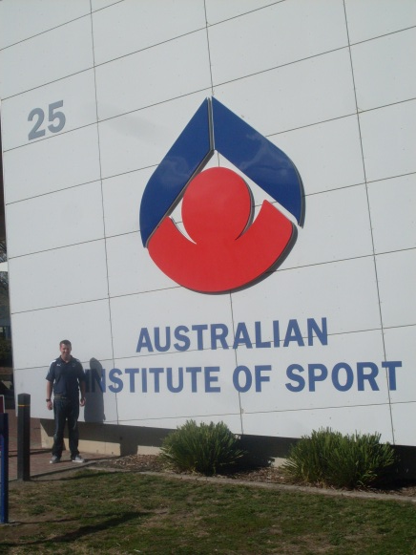
A journey overseas

Slide 3
So what did I learn?
How big my knowledge gap was and how poor my application was of game based pedagogies
Developed a better understanding of ‘Athlete Centred’ coaching
I needed to add to my coaching toolbox

Slide 4
So what did I learn?
And finally, I now realised that I needed to use better coaching interventions to address the key factors that were limiting performance, and identify task, environment and individual constraints (Newell, 1986) that could be used to link the learning that was required, to the learning opportunities of the game and or practice.

Slide 5
Athlete Centred Coaching
Fashionable term that is common in sport, but what does it mean?
‘Through training, athletes and teams gain some choice in and control over what happens’. Which Kidman (2010) states has the following advantages ‘athletes are motivated to learn and they have a greater understanding and stronger retention of both tactics and skills’.
Henry

Slide 6
What does it look like in practice?
Athletes leading on and having some control of
Tactics
Team culture
Team rules
Style of play
Putting the athlete at the centre of the process
TGfU (Bunker & Thorpe, 1982)
Constraints Led Approach (Newell, 1986)
Dynamical Systems Theory (Gleick, 1987;Kaplan & Glass, 1995; Kauffman, 1993, 1995; Waldrop, 1992; Yates, 1979)
Associated coach behaviours

Slide 7
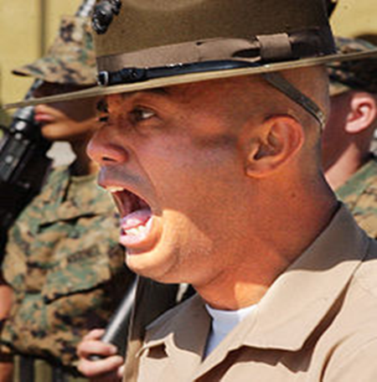
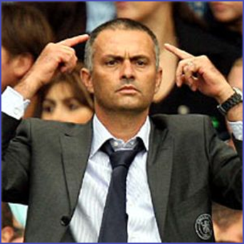
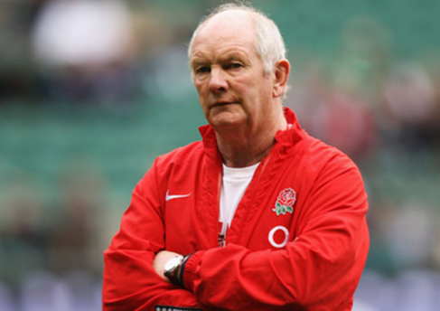
The ‘Athlete Centred’ Continuum
Tell
Coach centred Drill drill drill
What do you think? Game based

Slide 8
Some thoughts on Athlete Centred Coaching
Is telling bad?
Depends on your beliefs and values
Athlete centred is what is says on the tin
Who has the power, is that important?
What about the non negotiables?
Can we use a balance?

Slide 9
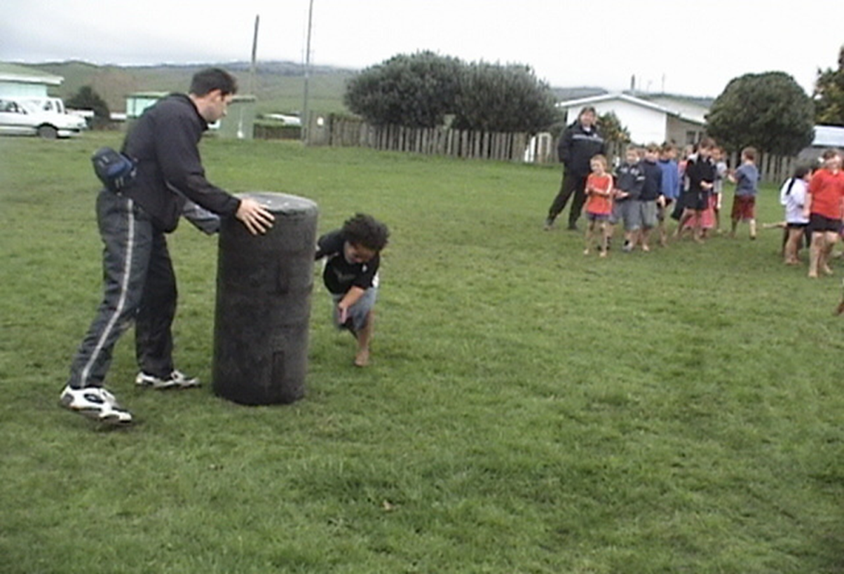
Don’t worry, its not for everybody
How did that feel?

Slide 10
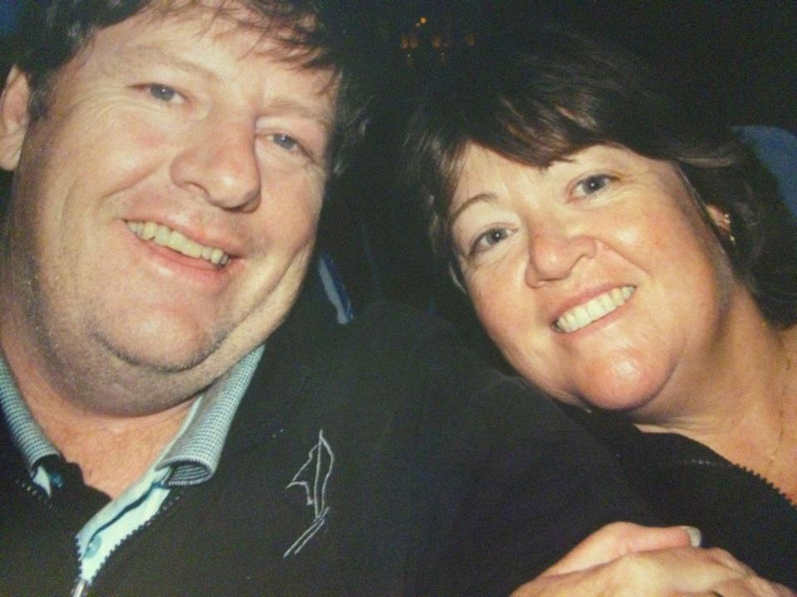
Sid's story
Sid’s thoughts on constraints and athlete centred coaching
G’Day apologies for the language

Slide 11
Summary
Apply critical thinking prior to applying an intervention
Identify when a balance is required
Communication is essential
Reflect on your journey
Seek advice from experts

Slide 12
Thanks for listening
www.wcmt.org.uk

